Slide 1
IFs and Nested IFs in Excel
Objectives:
Using the If function in spreadsheets
Nesting If functions

Slide 2
The IF function
The IF function is a logical function used for making decisions based on some condition(s)
Conditions have to result in Boolean values. (relational expressions, true/false)
Lends more flexibility since the results can be something else besides a simple True - False value
If your total points are less than 600 then display “Fail” in the cell otherwise display “Pass”

Slide 3
The IF function syntax
=IF(logical_test, value_if_true,value_if_false)
The IF function has 3 arguments - the first two are required
First argument <logical_test> : is any value or expression that can be evaluated to TRUE or FALSE.<condition>
Second argument: the value that is returned if logical_test is TRUE (then)
Third argument: the value that is returned if logical_test is False (else) – this argument is optional
Sometimes you may see the statement described as If(<condition>, if true then, else)

Slide 4
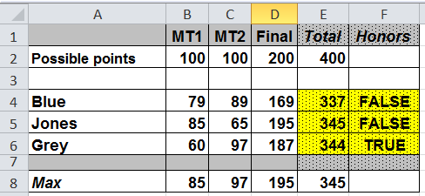
A simple IF formula
Write a formula in cell G4 to list whether this is an honor student as indicated by the letter H or a non-honor student as indicated with the letter R.
=IF(F4, “H”, “R”) or IF(F4=FALSE, “R”, “H”)
What would result if the “” marks around the letter H were omitted?.. Try it and see.

Slide 5
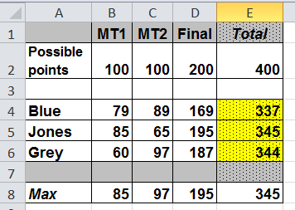
Examples – IF’s with relational expressions as conditions
Write a formula in cell F4 to determine if Blue passed or failed (a minimum of 300 points is required to pass)
=IF(E4>=300, “pass”, “fail”) or IF(E4<300, “fail”, “pass”)
Write a formula in cell G4 to determine Blue’s curved grade. If the grade is below 150 add 10%, if the grade is 150 or above the grade remains the same
=IF(E4<150, E4*1.1, E4)

Slide 6
IF’s with Boolean and Arithmetic functions in the condition
Write a formula in cell F4 to determine if Blue got an A - to get an A Blue needs to have the highest score on all 3 exams
=IF(And(B4=B8,C4=C8,D4=D8), “A”)
Write a formula in cell F4 to determine if Blue got a B. To get a B Blue needs to have a total score higher than the class average - otherwise he gets a C
=IF(E4>Average(E4:E6), “B”, “C”)

Slide 7
How can you write a formula that requires a series of conditions to be evaluated each dependent upon the results of the previous condition?
If Blue has at least 350 points he will get an A , else if he has less than 350 points but at least 300 points he will get a B, otherwise he gets a “C”

Slide 8
Before designing a nested-if formula – Use a logic diagram (Decision Tree) to understand the logic.
Blue gets an A
Does Blue
have at
least 350
points?
True
Blue gets a B
Does Blue have at least 300 points?
False
True
1st If statement
False
Blue gets a C
2nd If statement

Slide 9
NESTED IF
The second argument and/or third argument of an IF statement can be another IF statement - up to 64 levels of nesting! Here is an example with 2 levels of nesting – so three outcomes are possible.
IF(Blue has at least 350 points,
then he gets an A,
else IF(Blue has at least 300 points,
then he gets a B,
else he gets a C ) )

Slide 10
Nested IF Example
Write a formula in cell F4: If Blue has at least 350 points he gets an “A” , if he has less than 350 points but at least 300 points he gets a “B”, otherwise he gets a “C”
=If(E4>=350, “A”, IF(E4>=300, “B”, “C”))
1st logical test
Value-if-True
Value-if-False is a nested If

Slide 11
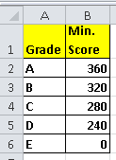
Now apply letter grades based on this grading scheme
grades!
=If(E4>=grades!B$2, grades!A$2,
If(E4>=grades!B$3, grades!A$3, If(E4>=grades!B$4, grades!A$4, If(E4>=grades!B$5, grades!A$5, grades!A$6))))

Slide 12
Order matters with criteria that are not mutually exclusive
Blue gets scholarship A if he received more than 340 points, if he didn’t get scholarship X but has at least 160 points on the final he’d get scholarship Y – otherwise no scholarship.
=If(E4>340, “X”, IF(D4>=160, “Y”, “none”))
1st logical test
Value-if-True
Value-if-False is a nested If

Slide 13
What to remember about using IF’s
An IF function allows you to make a decision based on a criteria. The first argument contains the logical_test, the 2nd the value-if-true and the 3rd (optional) the value-if-false.
For any IF statement, either the second argument (TRUE) or third argument (FALSE) is applied, not both.
Consider if the criteria are not mutually exclusive this will affect the order of the arguments.
In a Nested IF statement, each IF must be complete with all required arguments specified and a corresponding set of ( ).

